Slide 1
Exploring Splunk
Pushpa, Sowmya & Abhishek

Slide 2
Splunk
What is Splunk?
Splunk is a powerful tool for analyzing large amounts of data from different sources in real-time.
Key Features
Real-time Insights: Provides immediate visibility into data for monitoring and analysis.
Easy Search: Offers a simple yet robust search function for navigating data efficiently.
User-Friendly: Intuitive interface makes data analysis accessible to users of all levels.
Scalable: Can handle growing data needs and adapt to changing business requirements.
Uses
Splunk is used for IT operations, cybersecurity, business analytics, and more, aiding in troubleshooting, security monitoring, and decision-making.

Slide 3
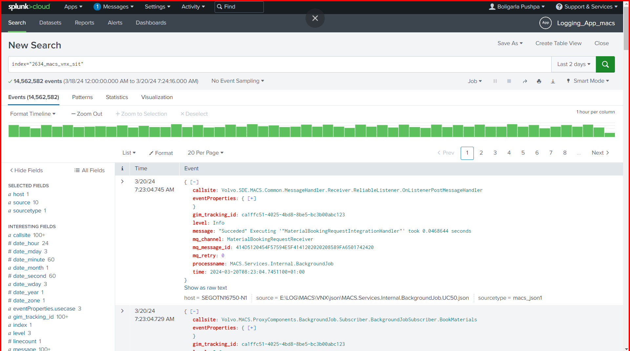

Slide 4
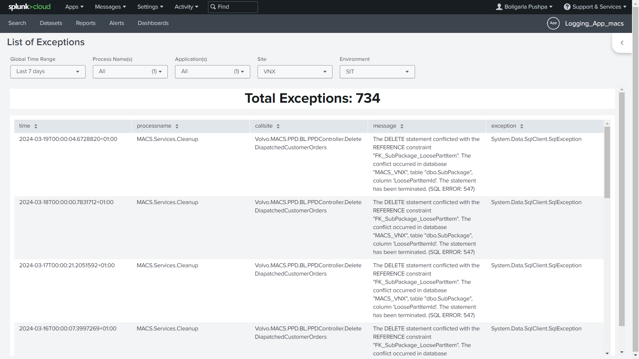

Slide 5
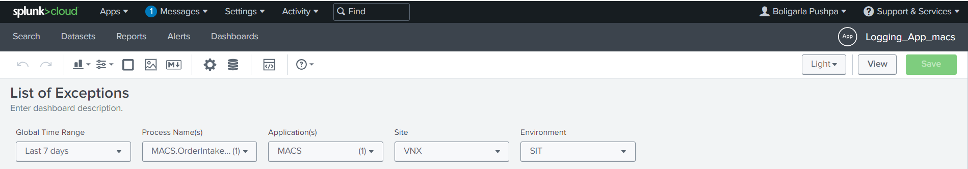
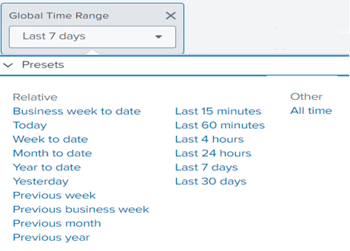
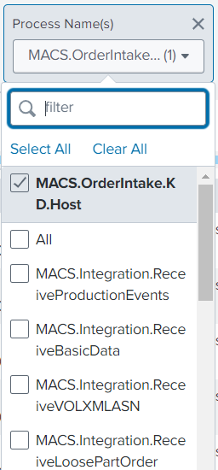
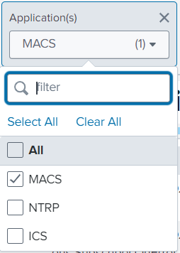
Search Filters

Slide 6
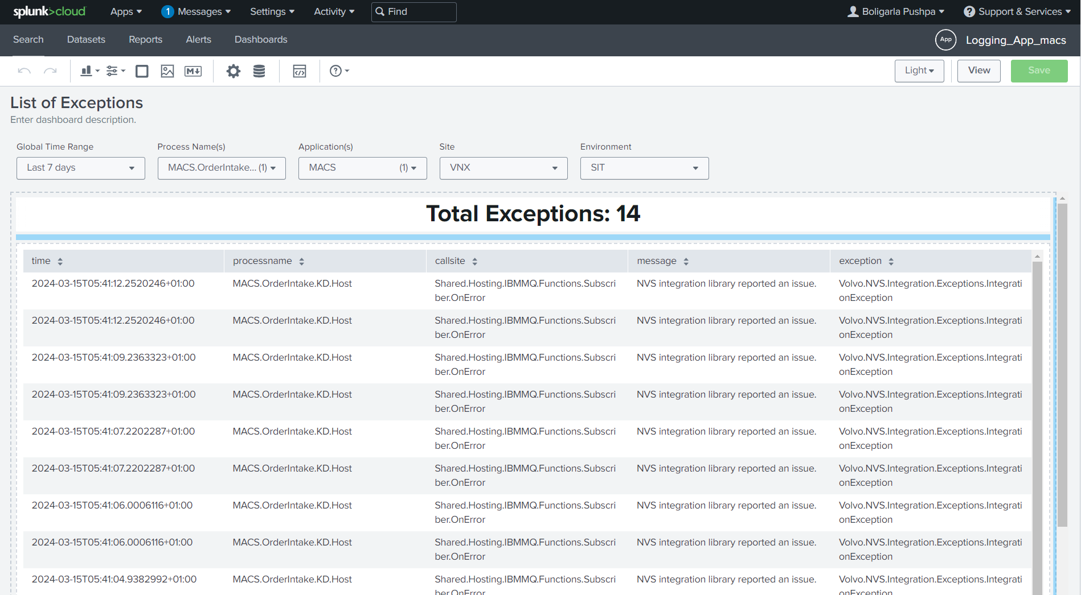

Slide 7
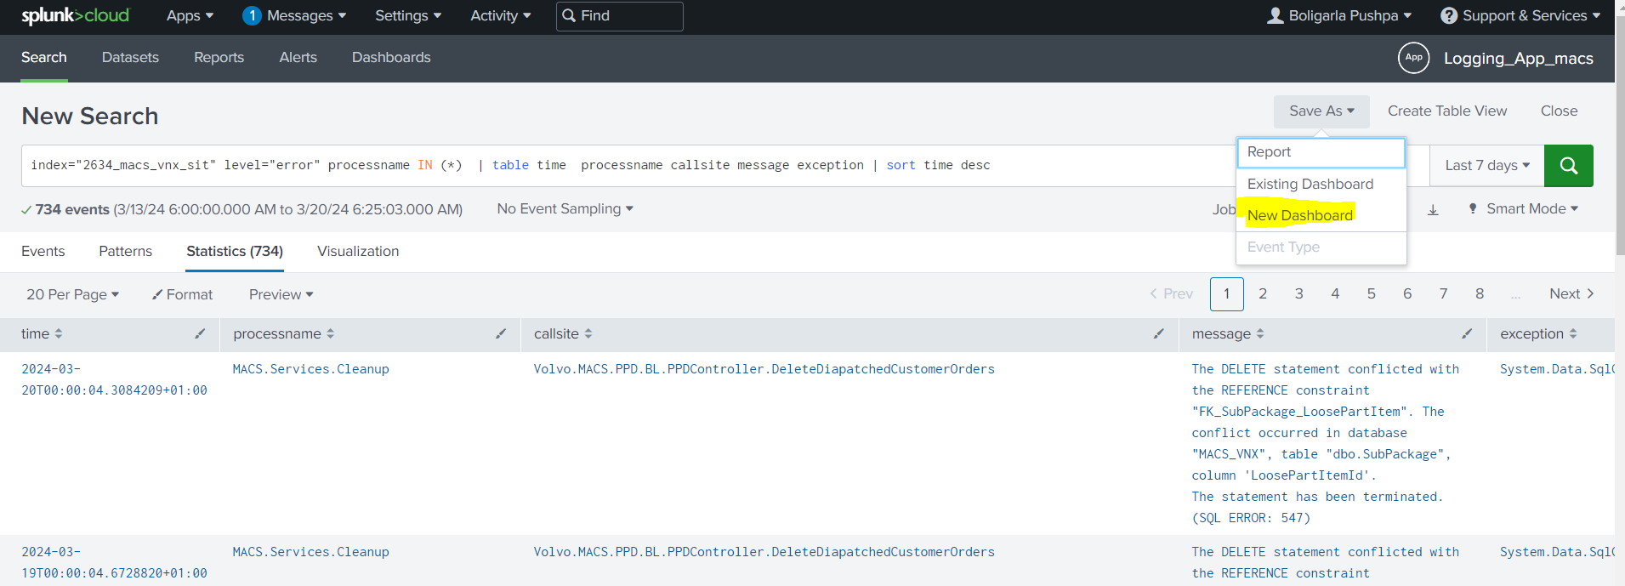
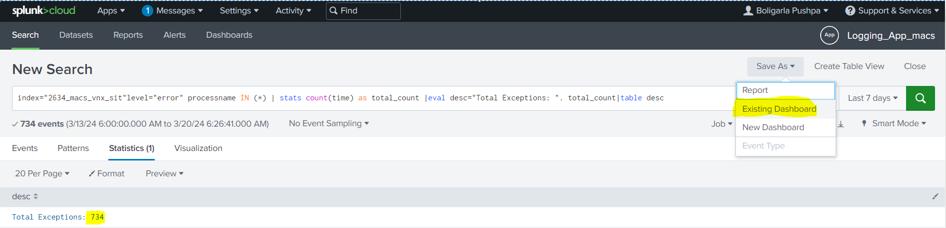
Queries Applied in Exception List Dashboard

Slide 8
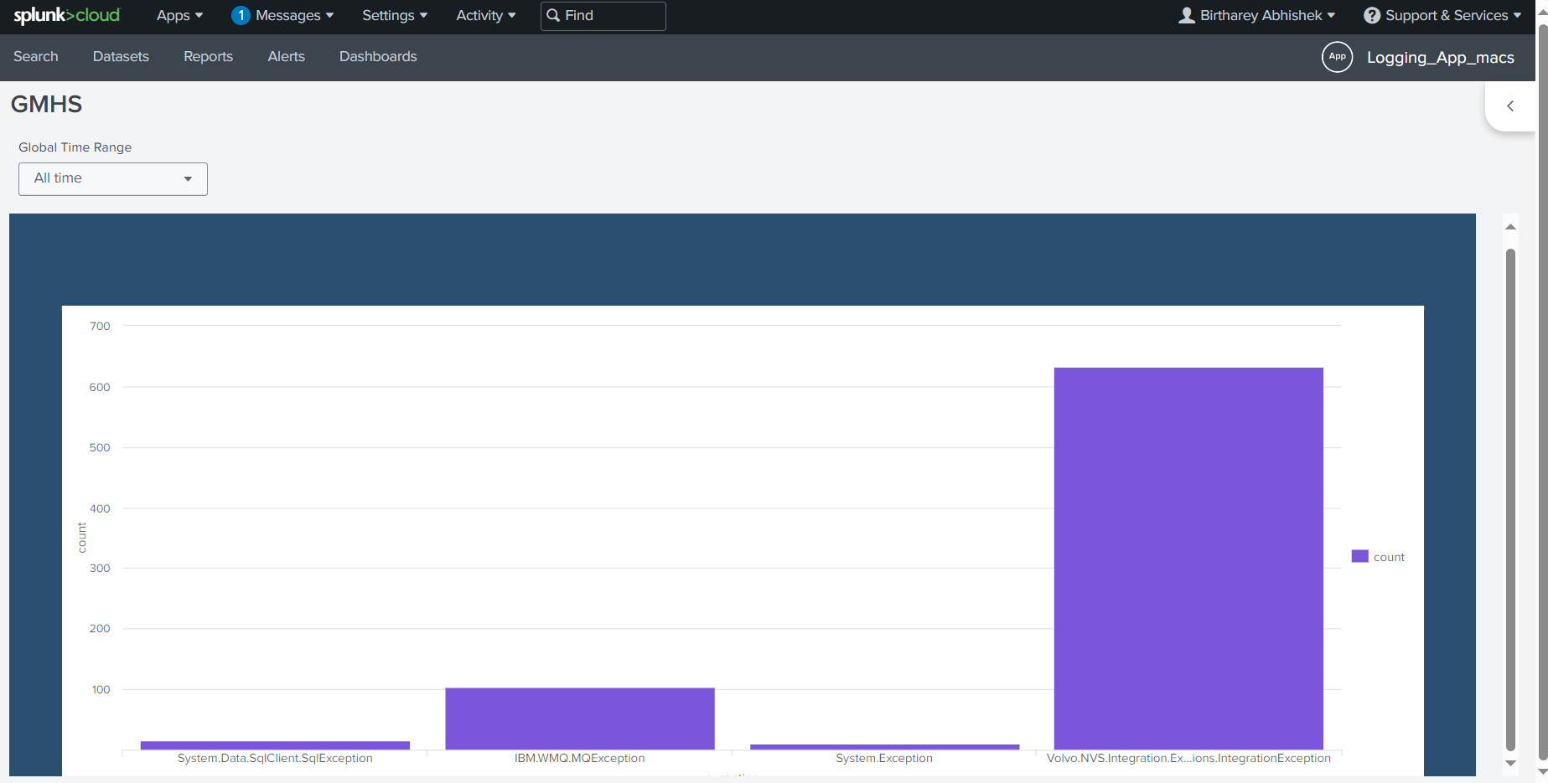
Bar chart to display the count of exceptions

Slide 9
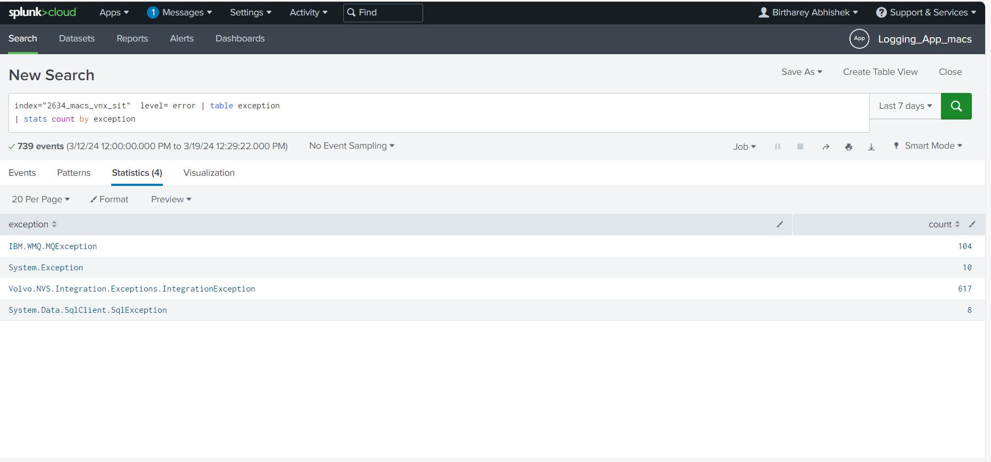

Slide 10
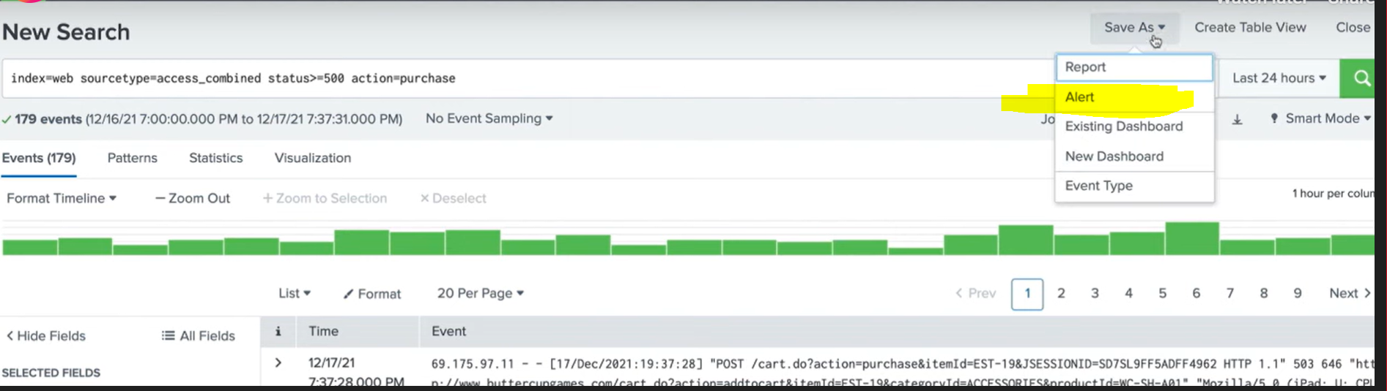
Creating Alert

Slide 11
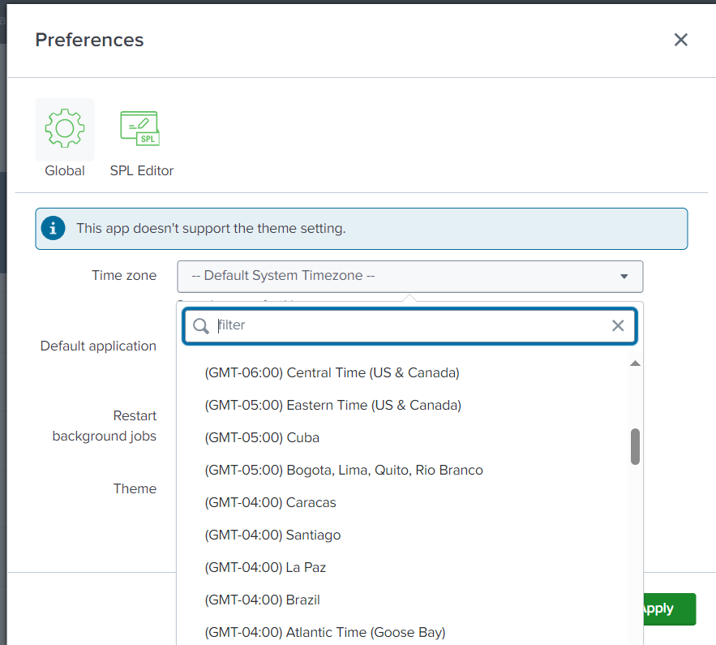
Changing the timezone to Local

Slide 12
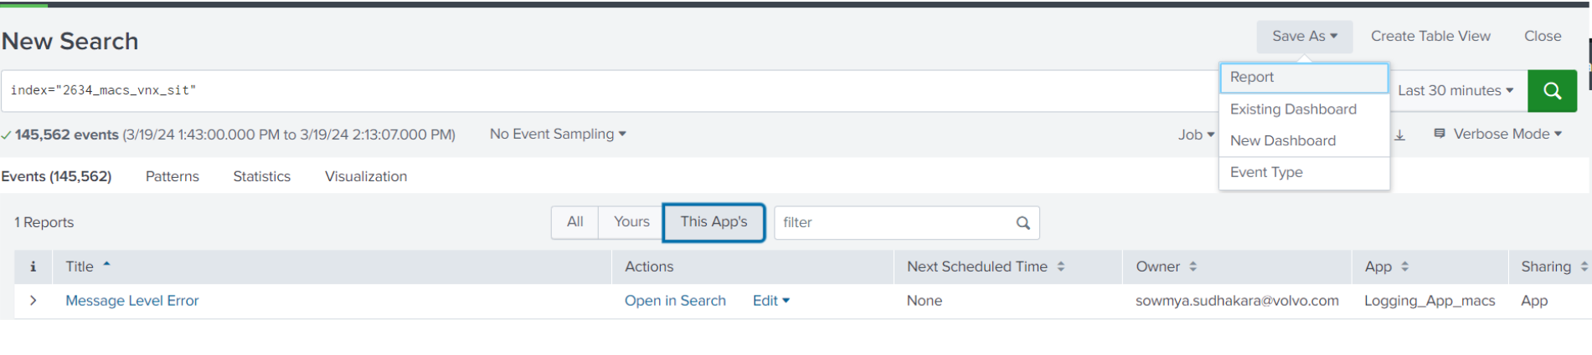
Creating Report

Slide 13
Thank You

